Slide 1

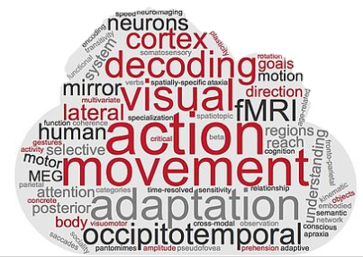
RSA: Tonghe’s project Day 5
Tonghe & Zuza

Slide 2
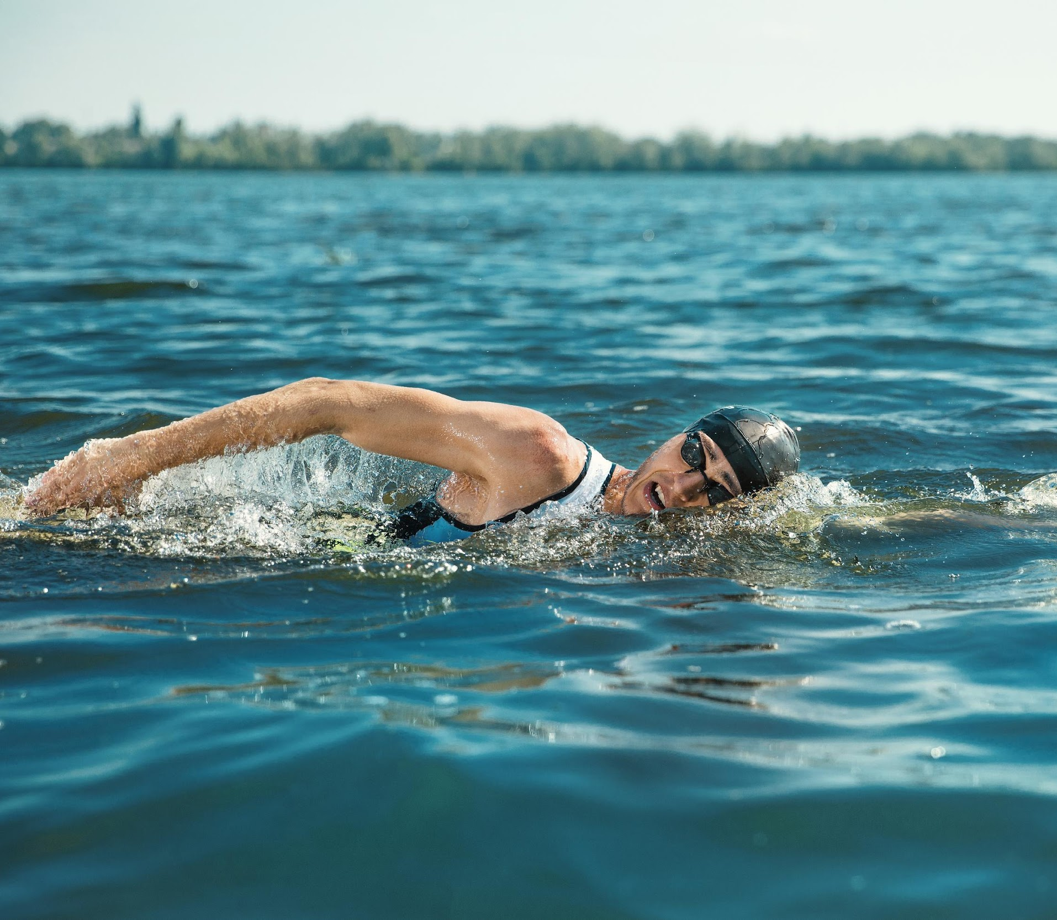
Hierarchical Action organization
Subordinate
Basic
Superordinate
To swim front crawl
To swim
Locomotion

Slide 3
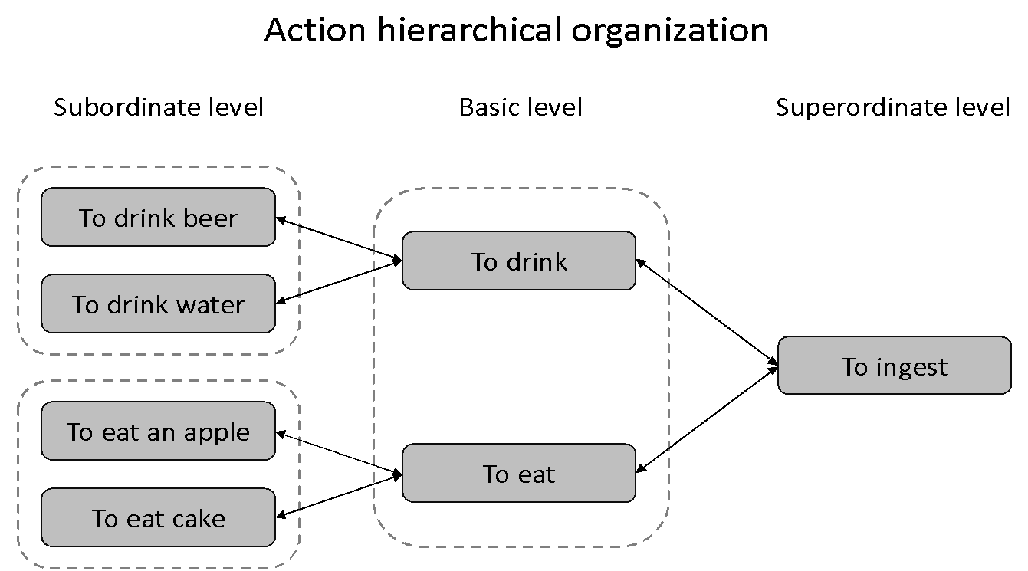
Hierarchies
--Action hierarchical organization--

Slide 4

Questions
How is the hierarchical organization of observed actions represented in the human brain? –fMRI

Slide 5
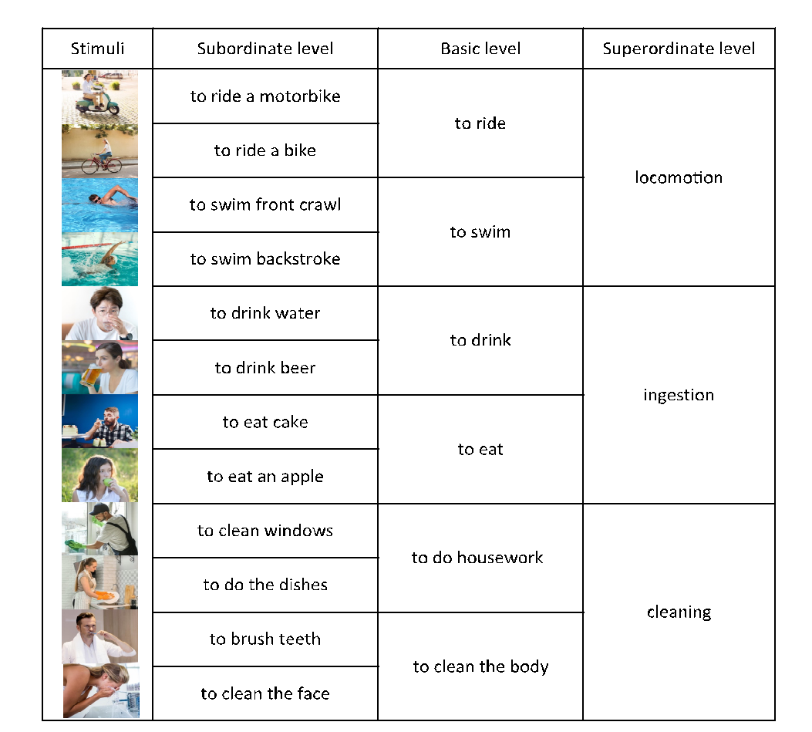
fMRI Experiment

Slide 6
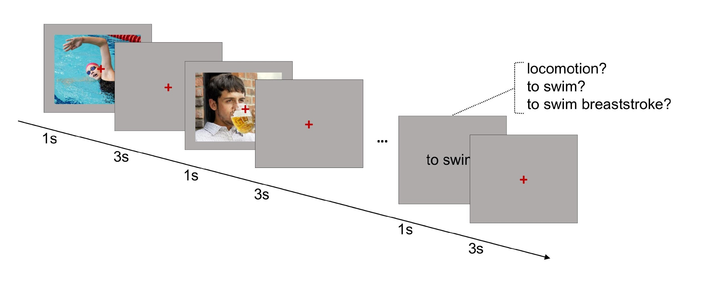
fMRI Experiment
--Design--

Slide 7
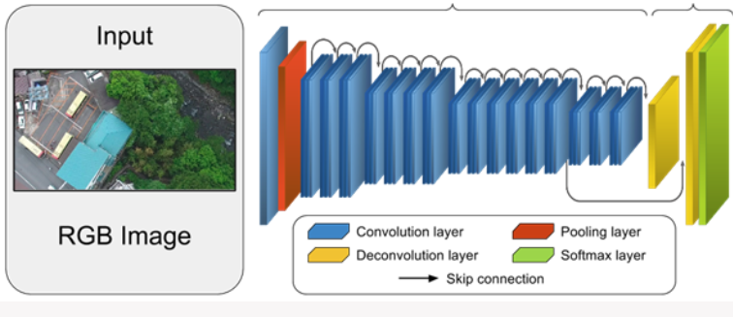
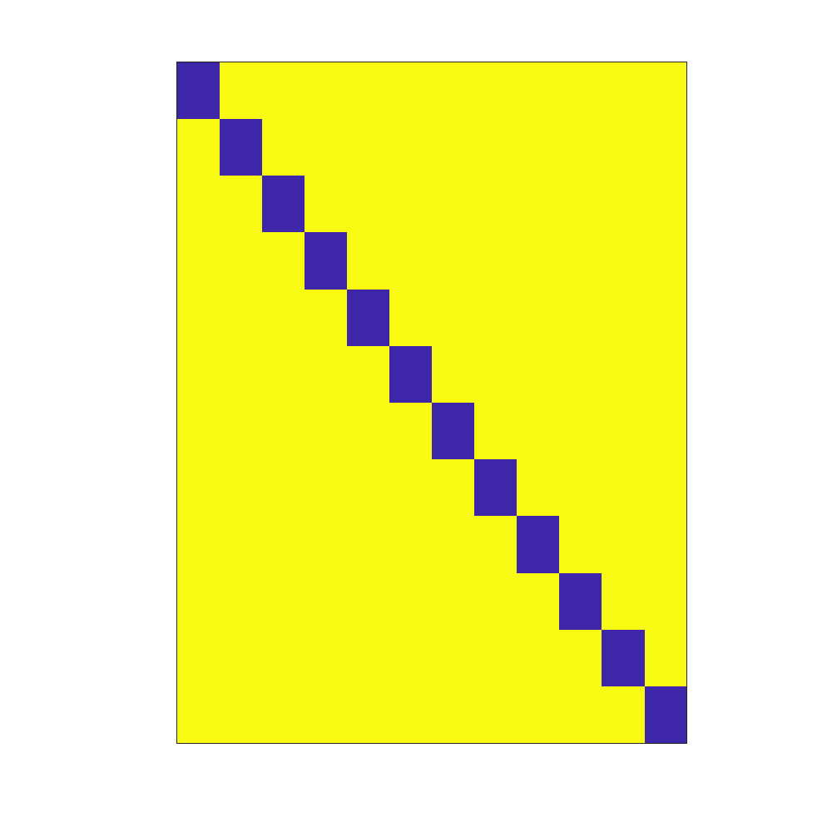
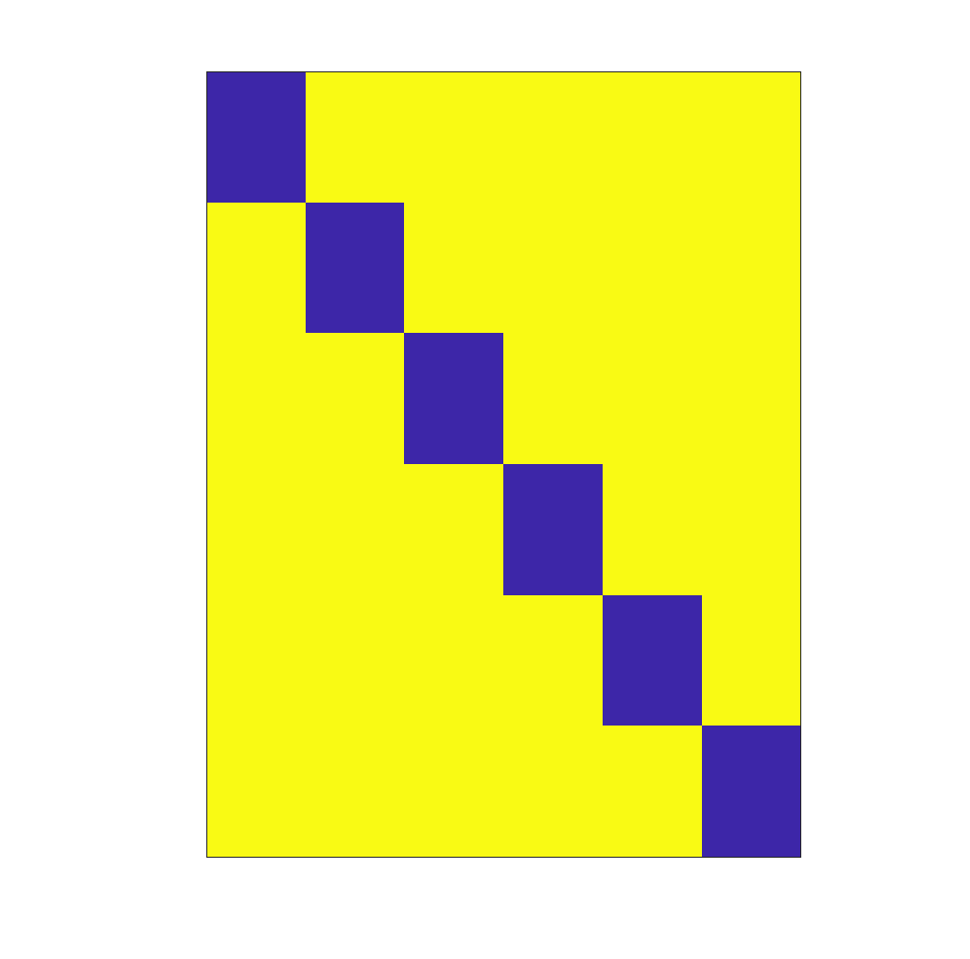
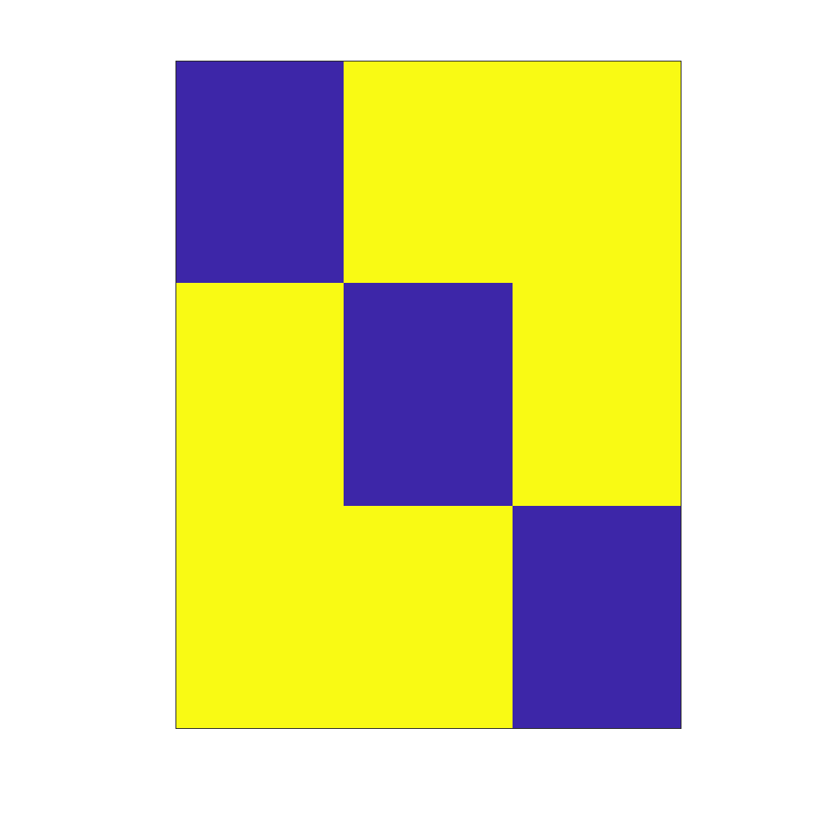
RDM models
Resnet50
Visual control model
Subordinate level
Basic level
Superordinate level

Slide 8
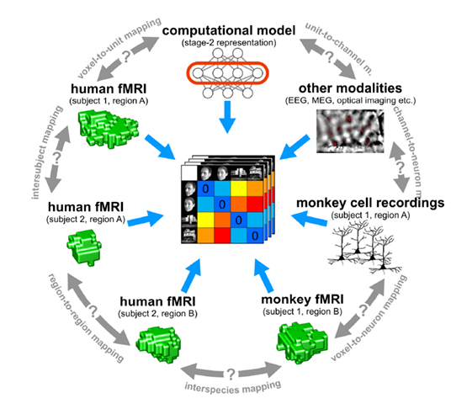
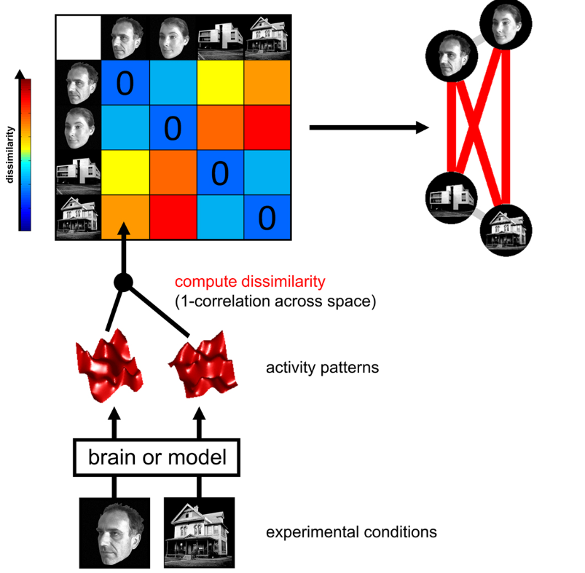
RSA analysis
(Kriegeskorte et al., 2008)

Slide 9
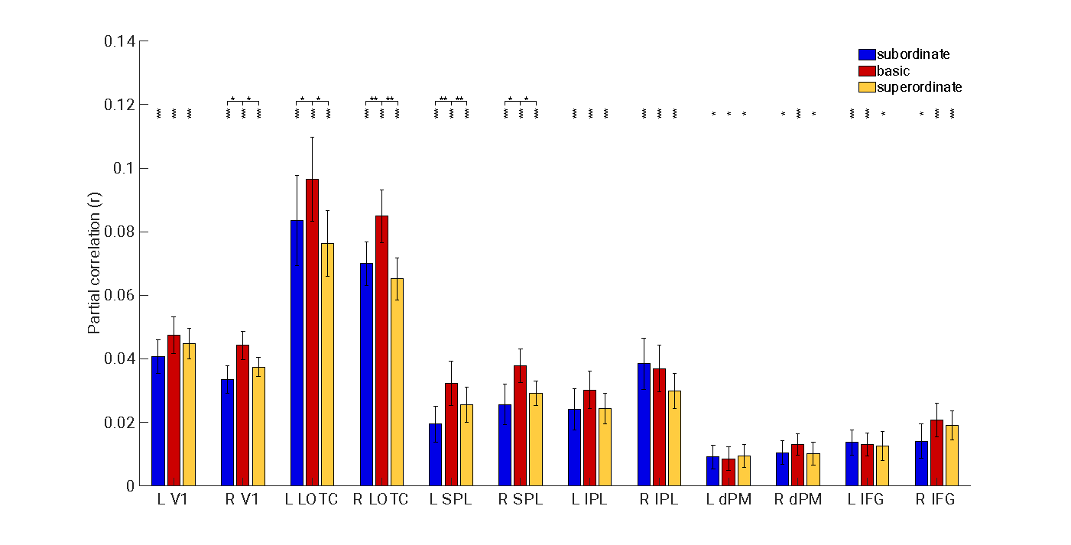
ROI-based RSA Results

Slide 10
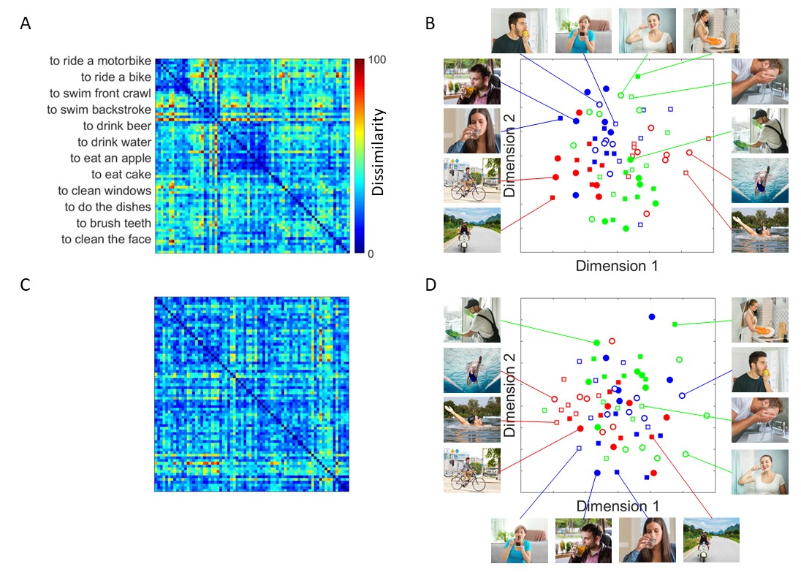
RDM and MDS
LOTC
V1

Slide 11
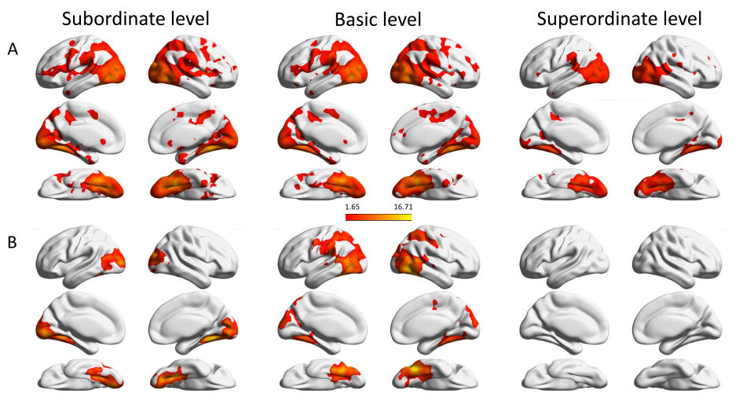
Whole-brain searchlight Results
GLM-No.1
GLM-No.2

Slide 12
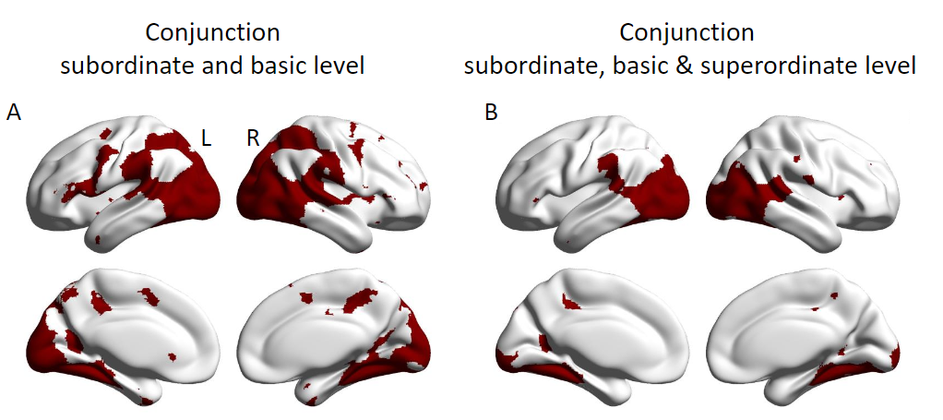
Whole-brain searchlight Results

Slide 13
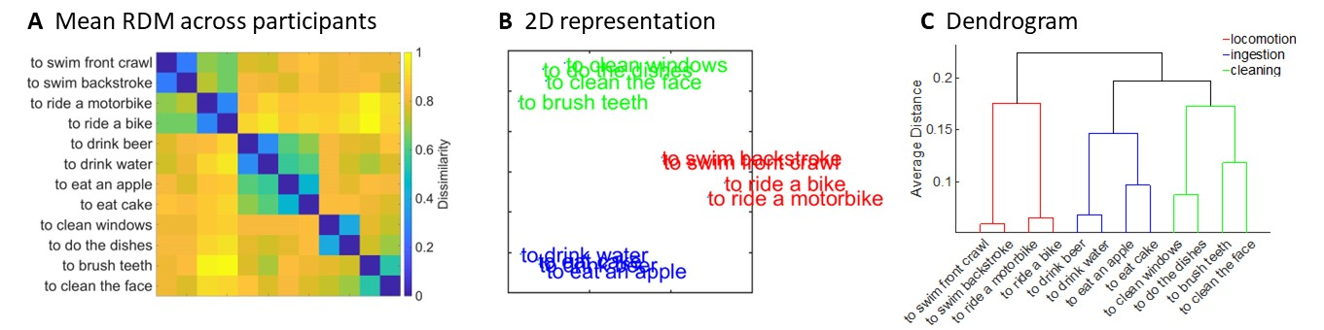
RSA: behavioral model

Slide 14
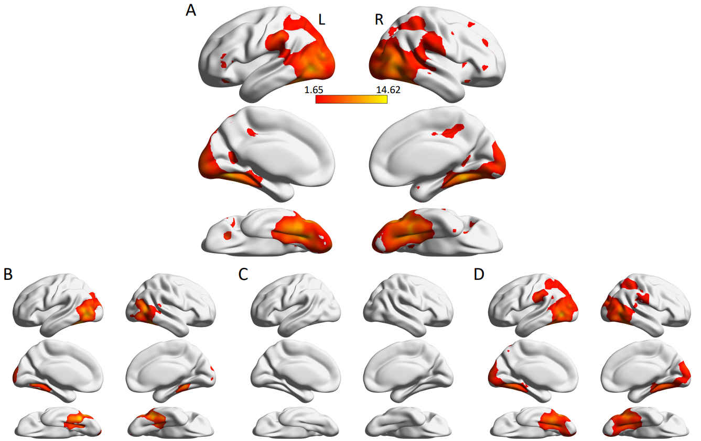
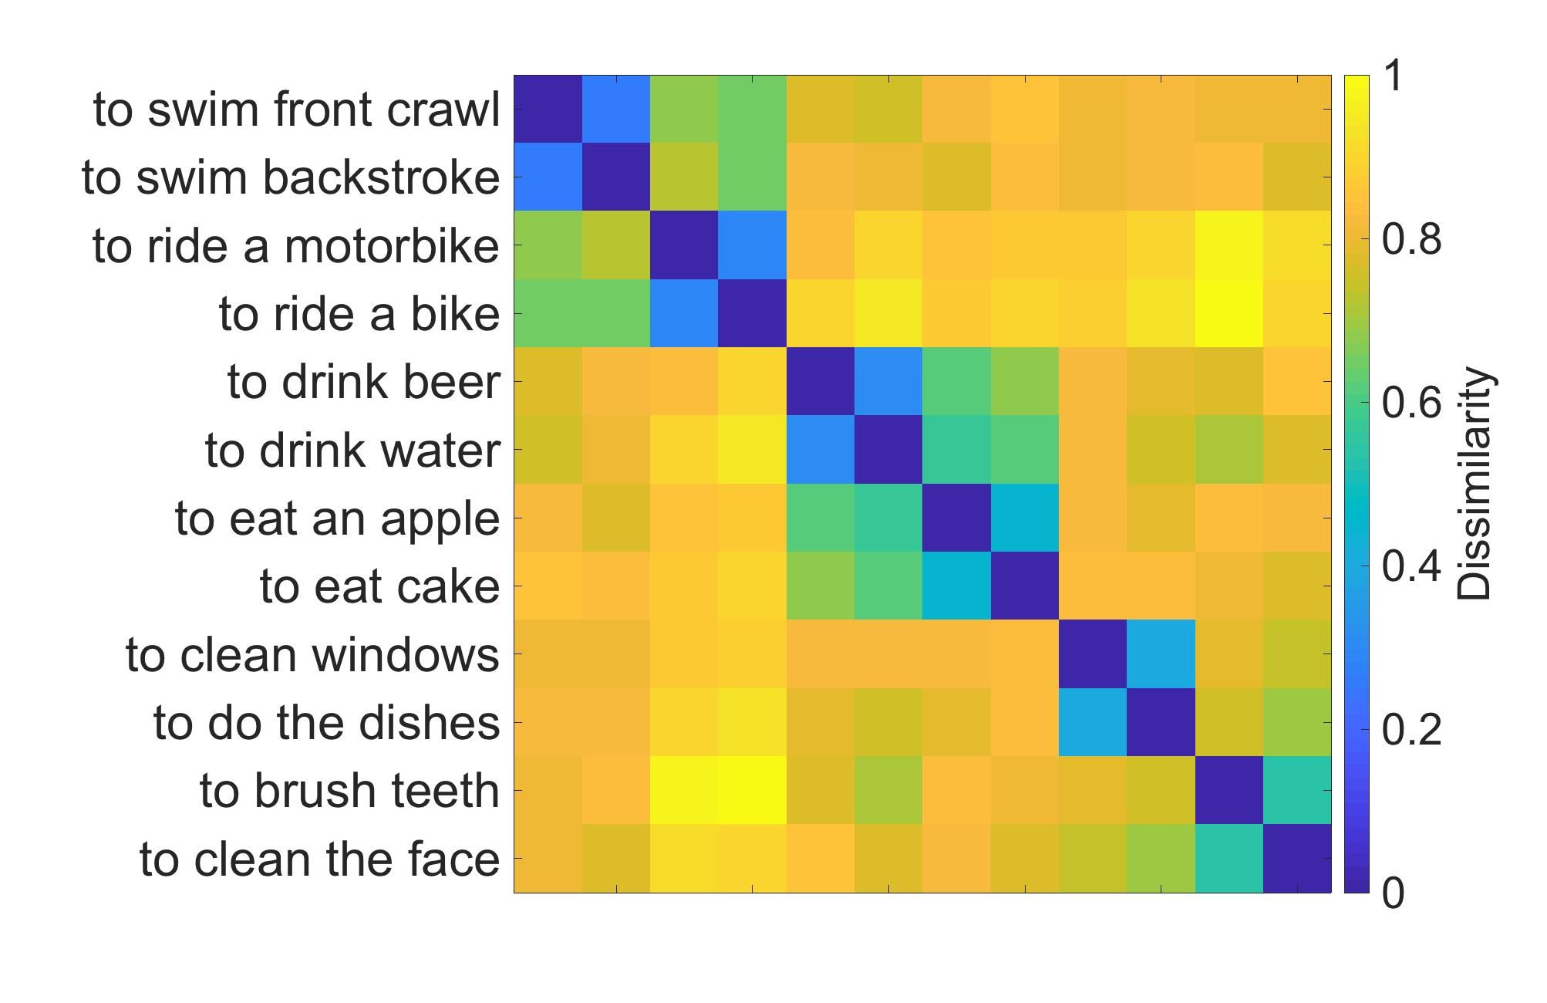
RSA: behavioral model
Behavioral RDM across participants
Removing subordinate RDM
Removing basic RDM
Removing superordinate RDM

Slide 15

Conclusion
Occipitotemporal cortex has flexible access to action representations across all three taxonomic levels, with a preference for the basic level model, in line with the view that (a) this region plays a key role in the representation of action categories at multiple levels of abstraction, and (b) that the basic level plays a key role in categorization.

Slide 16
RSA: Zuza’s project
Tonghe & Zuza

Slide 17
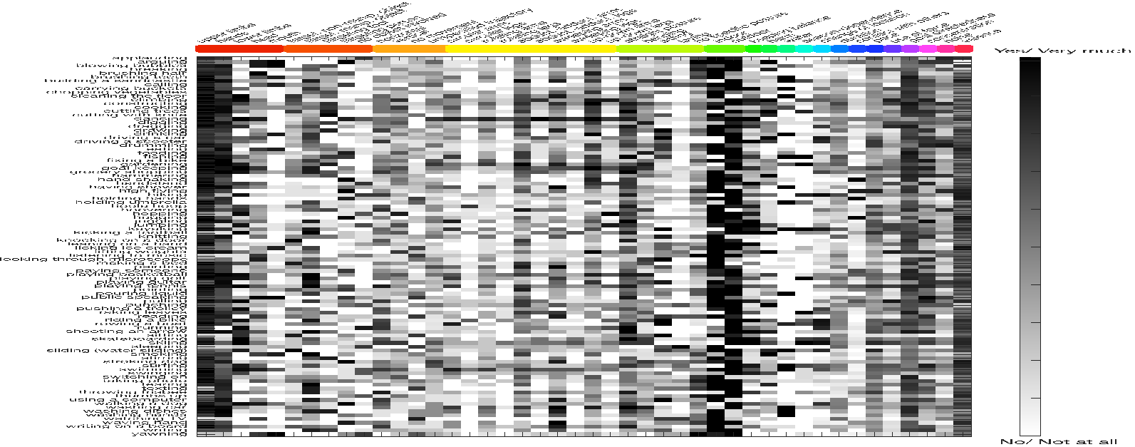
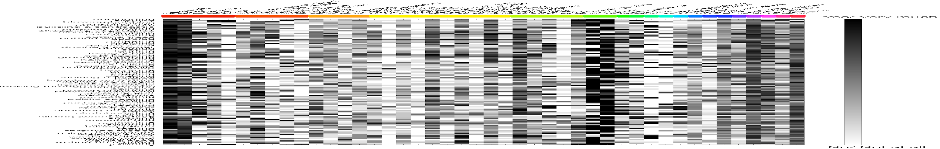
…
Notes:
Within reliability mask

Slide 18
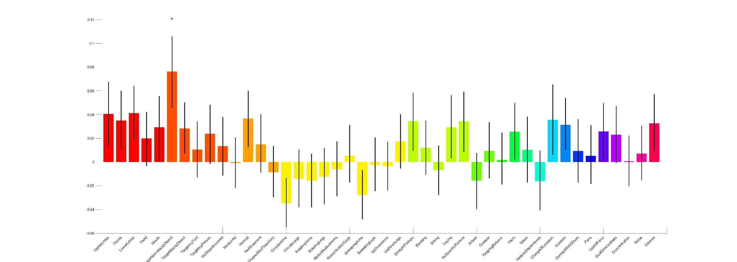
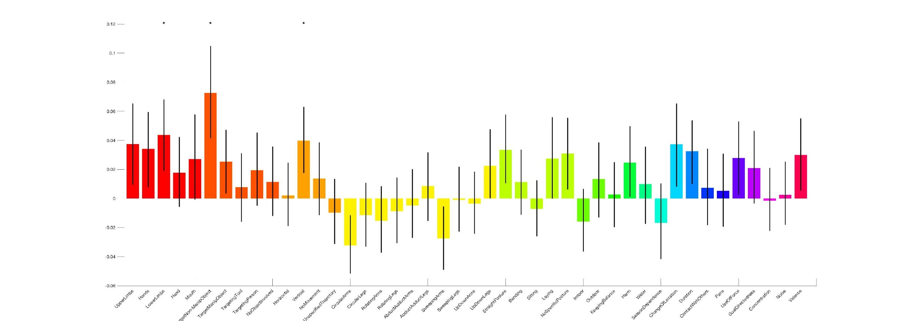
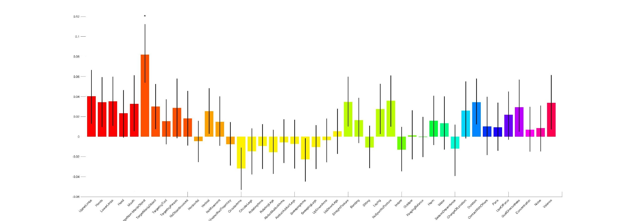
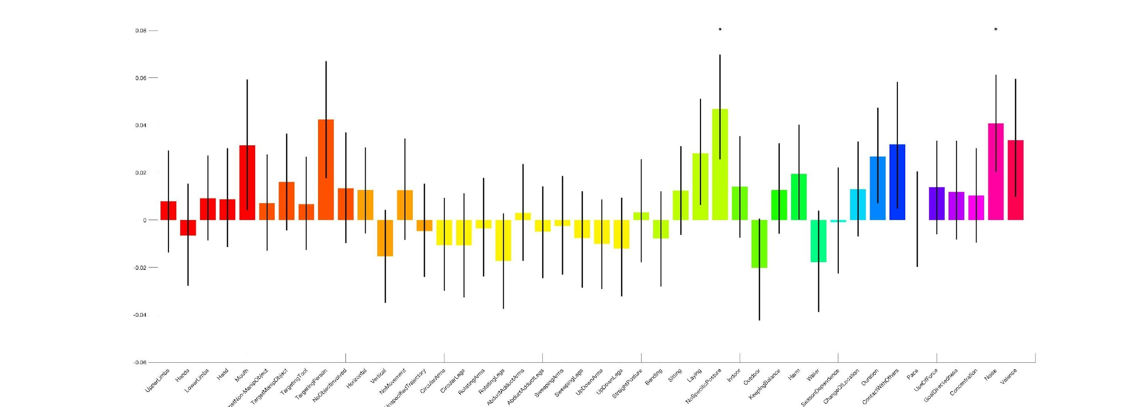
ROI structure (of cluster peaks from RSA) – Feature correlations
Category clust – standard RSA
Category clust – GLM-based RSA
Feature clust – standard RSA
Feature clust – GLM-based RSA
Notes:
Within reliability mask

Slide 19
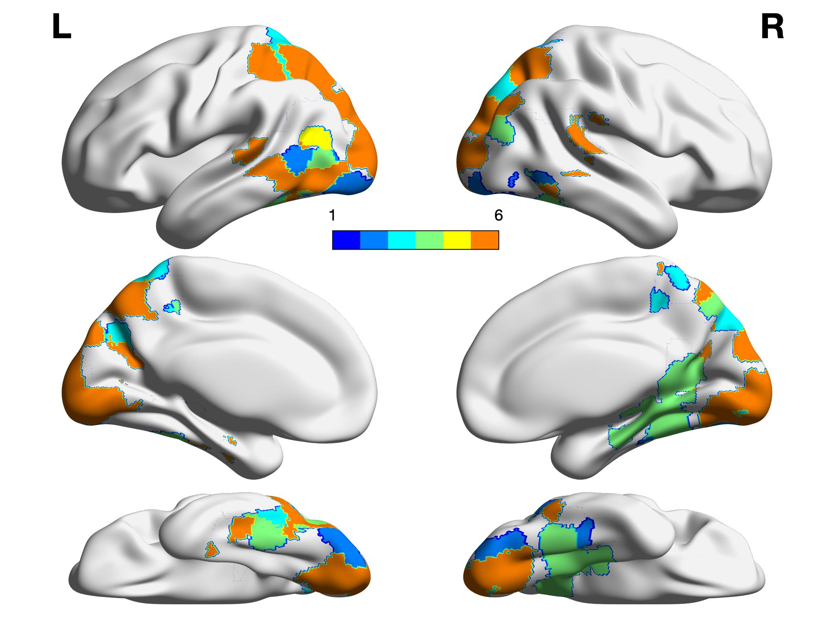
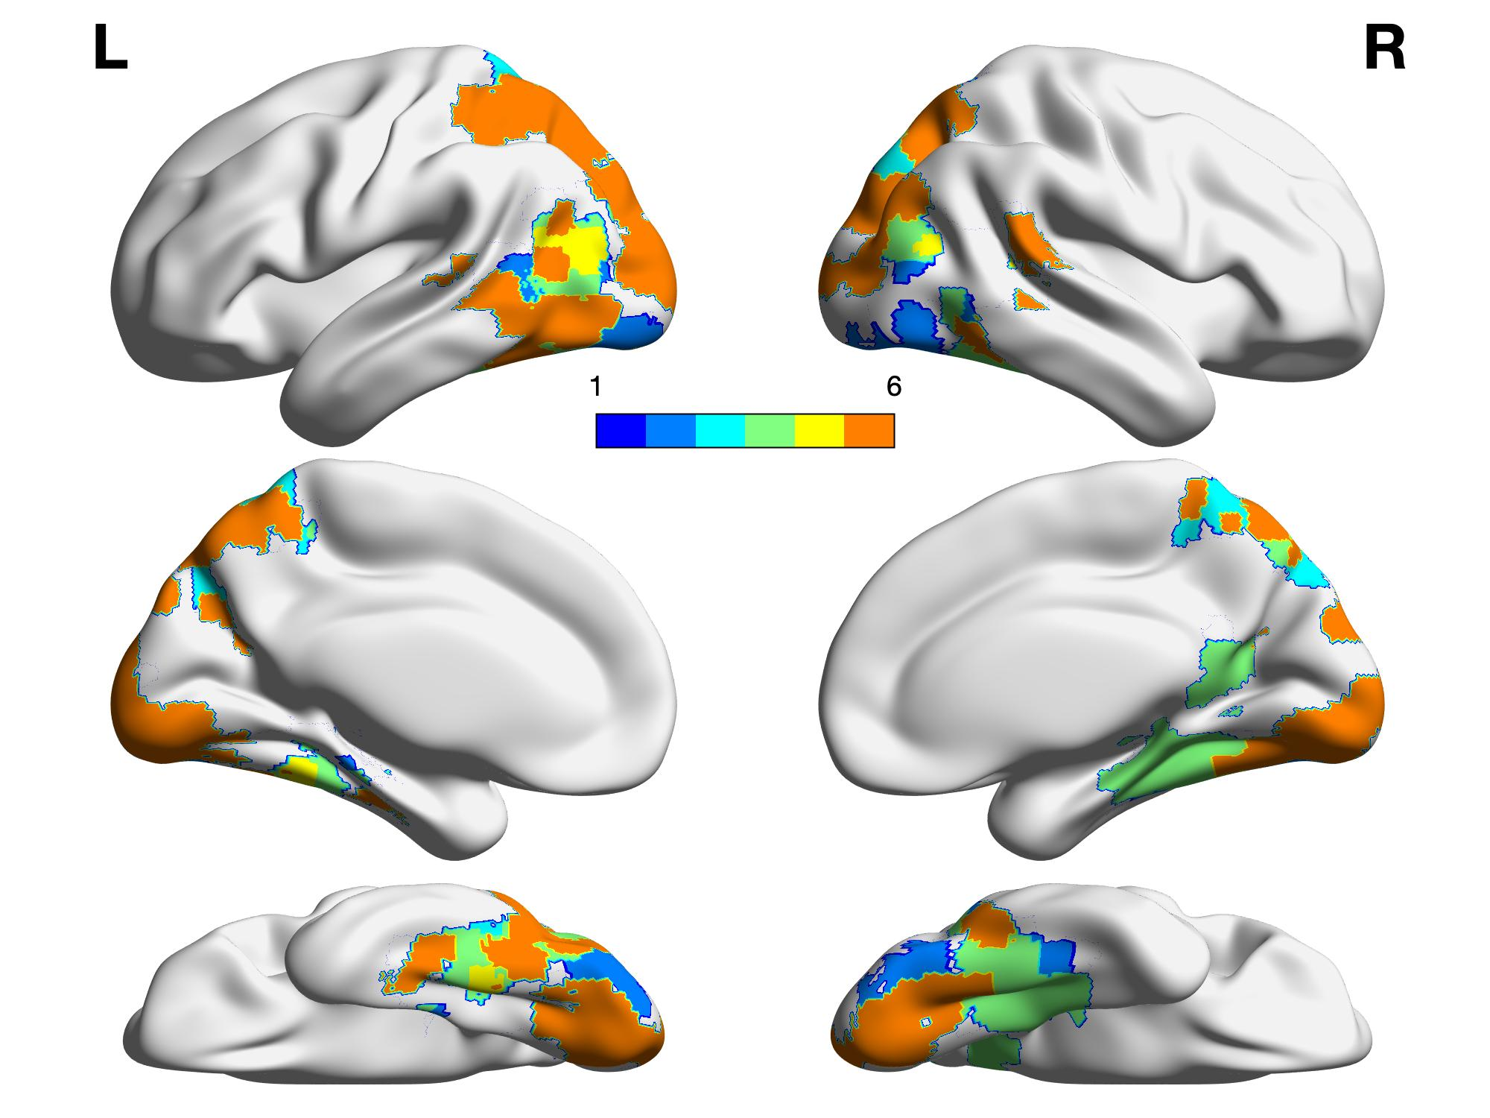
Principal Component Analysis
4. Winner-take-it-all with PCs
General movements
Upper limbs
Context
Posture
Contact with others
Object-directedness
thr=0

Slide 21
Q & A
Tonghe & Zuza

